Slide 1


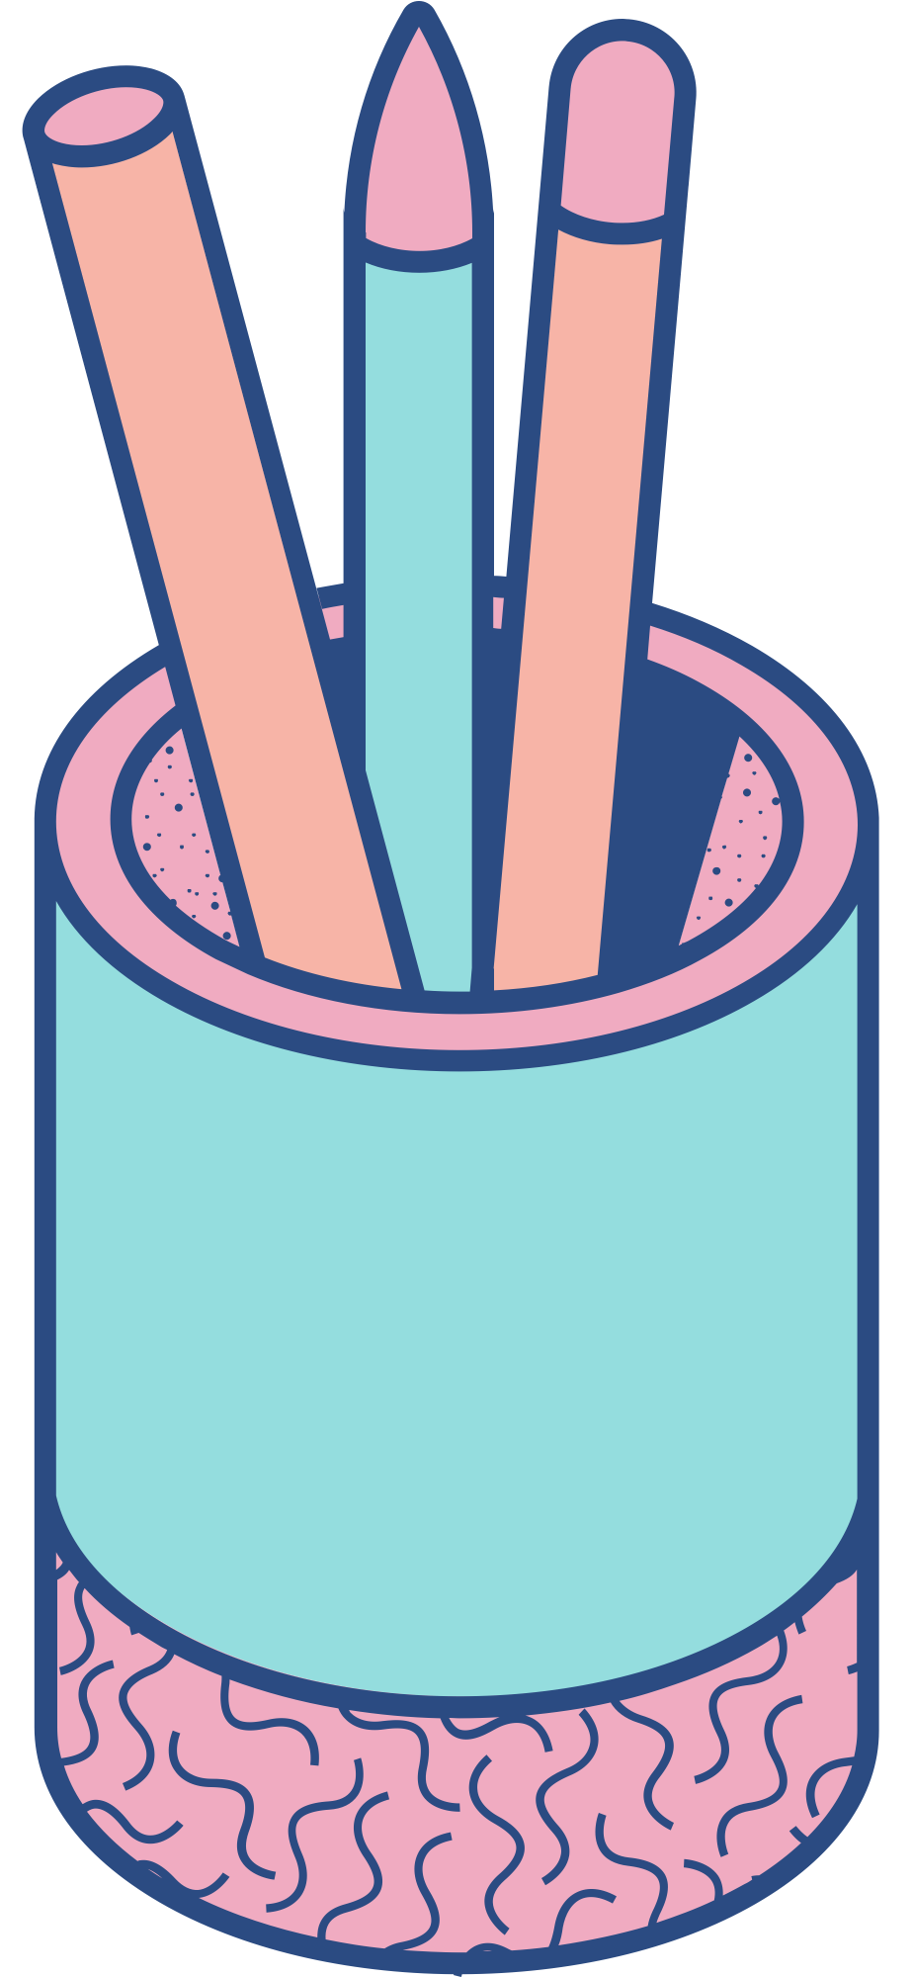



AuctionNest
America’s Auction House
TEAM 7
TRI-ALLIANCE
SAMEER SHAIK
VIVEK KOMMAREDDY
PRAKYA CHOWDARY

Slide 2
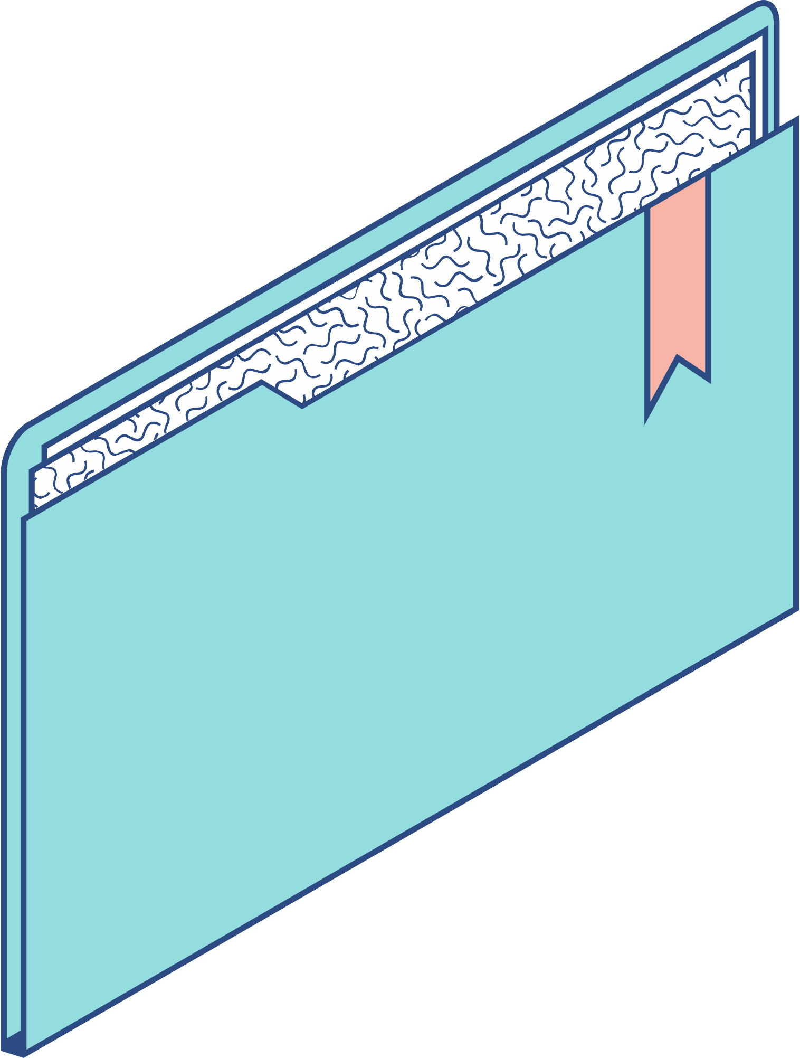
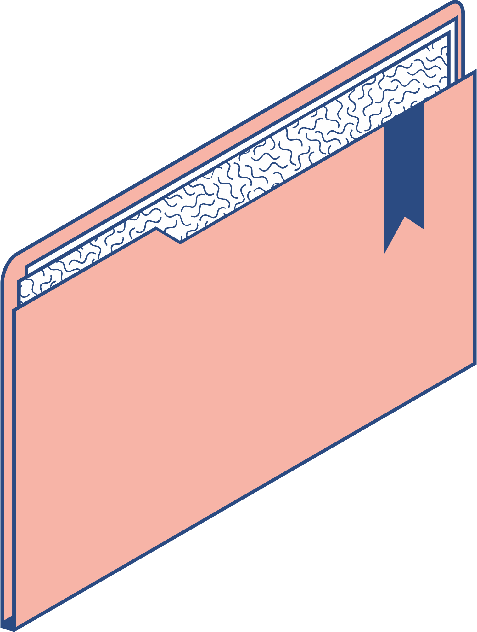
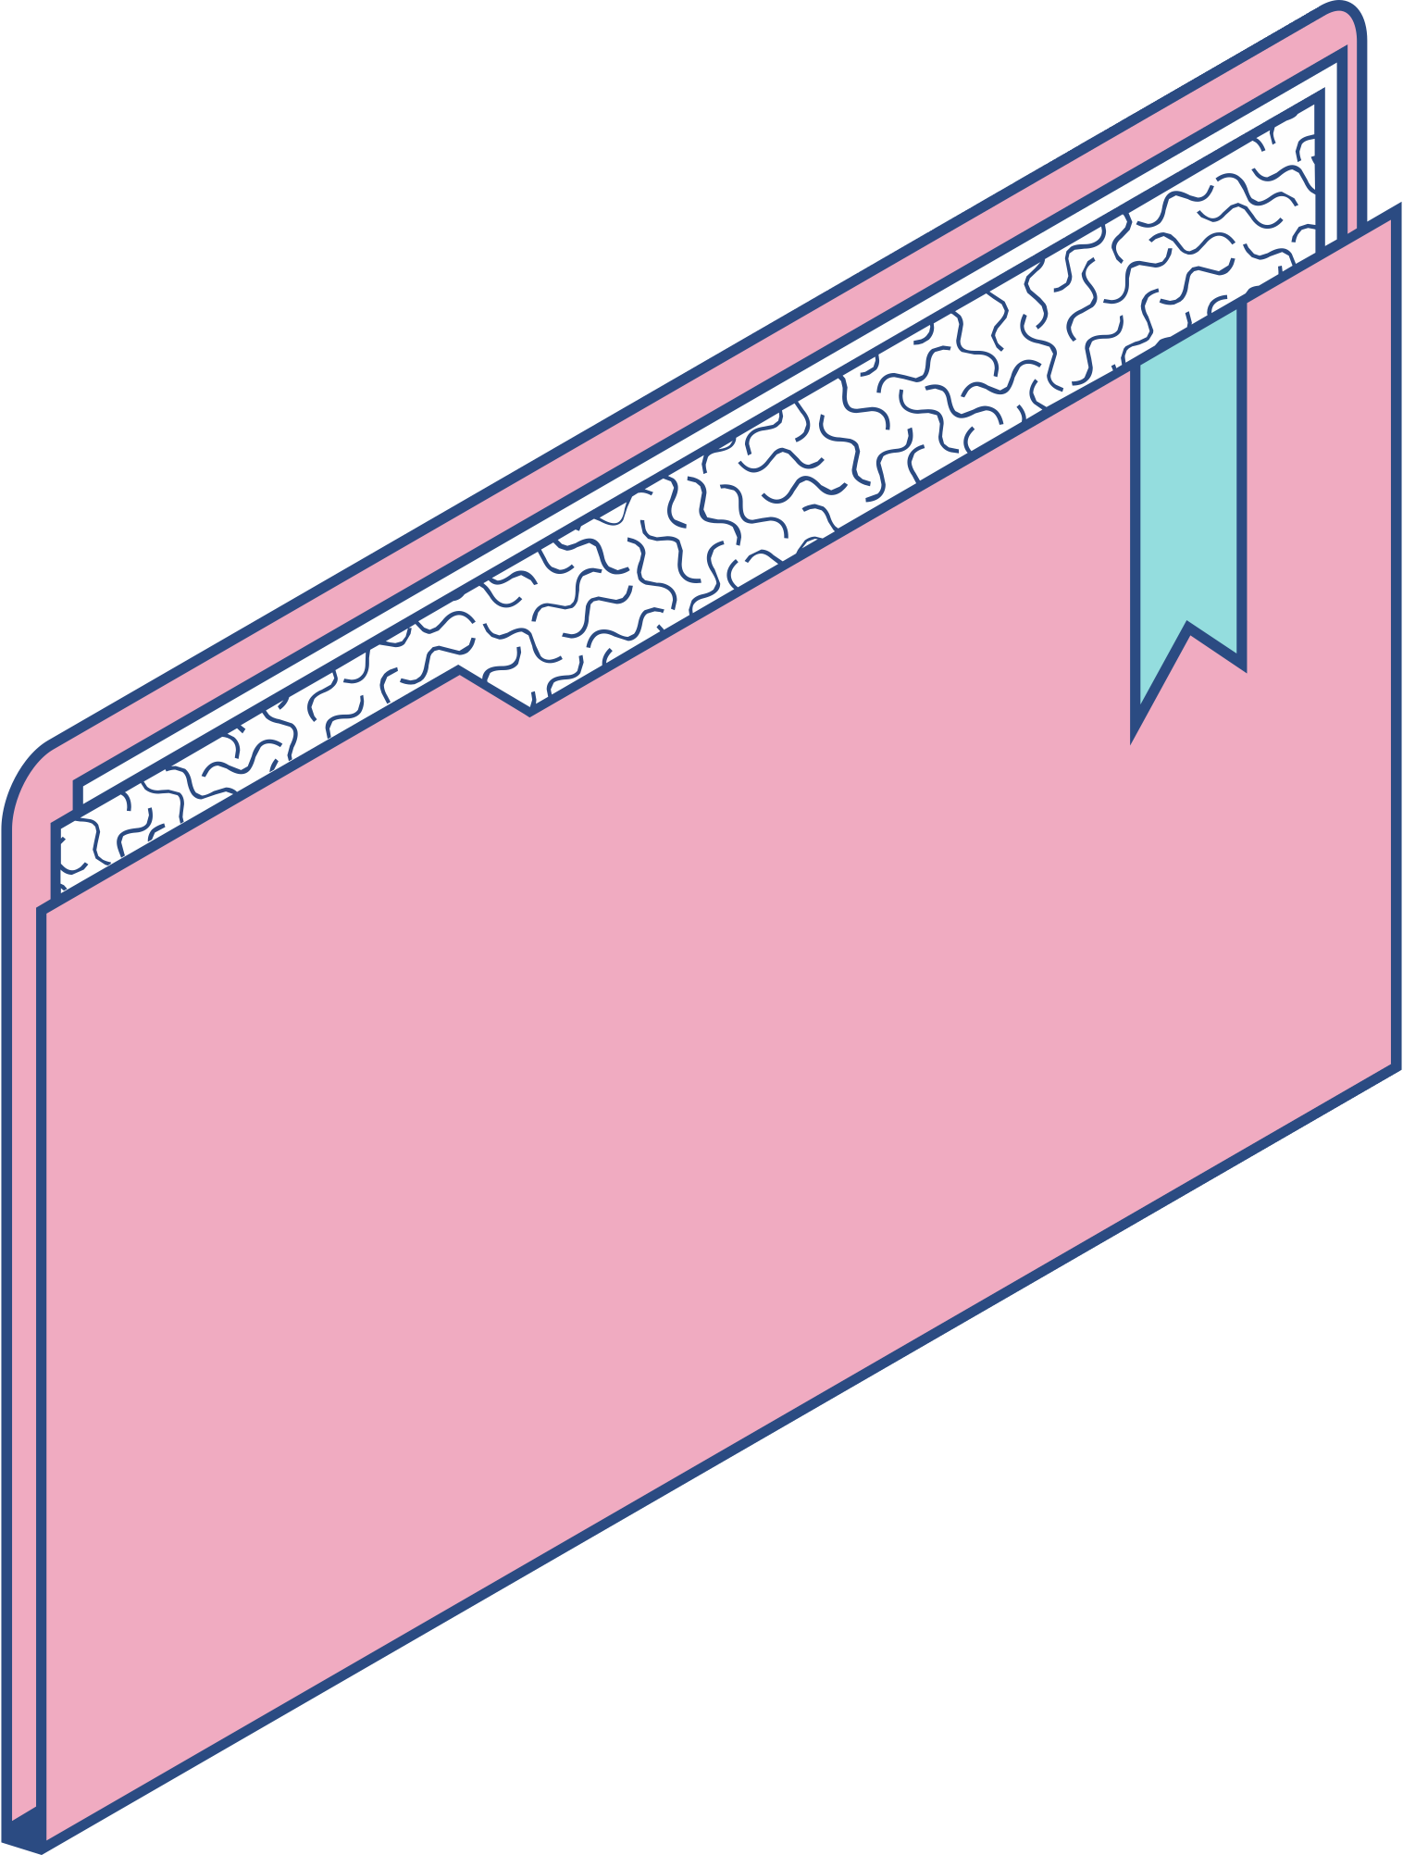
Software Development Approach
Spiral Model

Slide 3
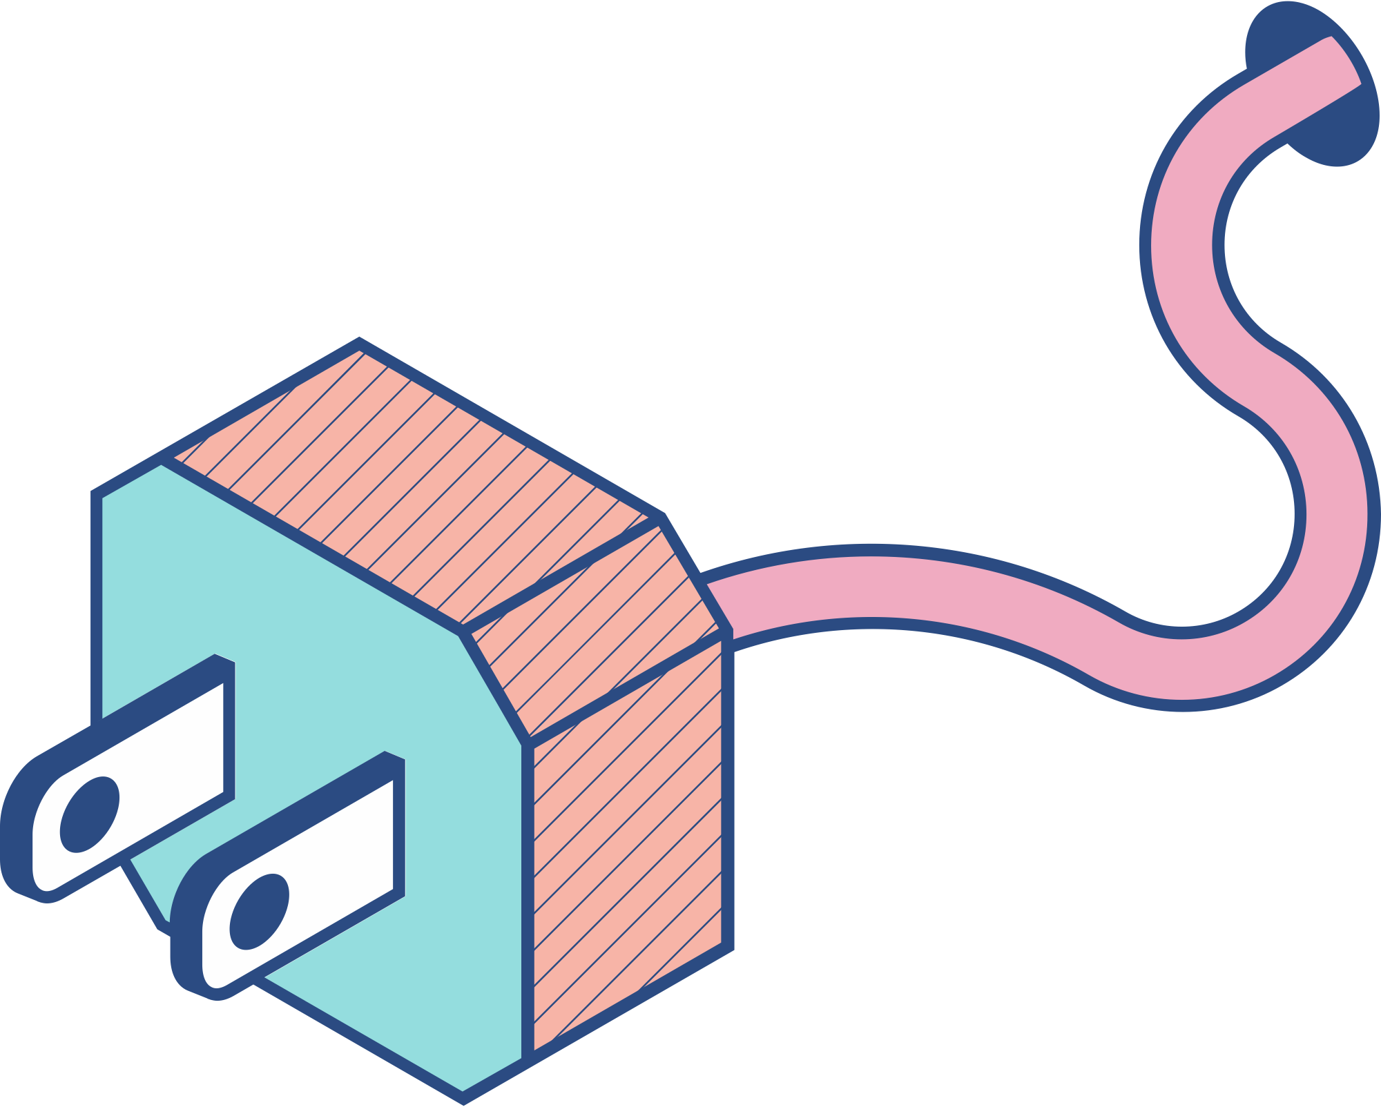
Software Development Approach
We have selected the Spiral Model, a risk-driven software development process model, for the development of AuctionNest. The Spiral Model provides an iterative approach to managing the project, enabling the team to address risks and refine the product progressively through repeated cycles of development. This model focuses on early identification and mitigation of risks, making it especially suitable for complex projects like AuctionNest, where requirements may evolve and potential risks need to be carefully managed.

Slide 4
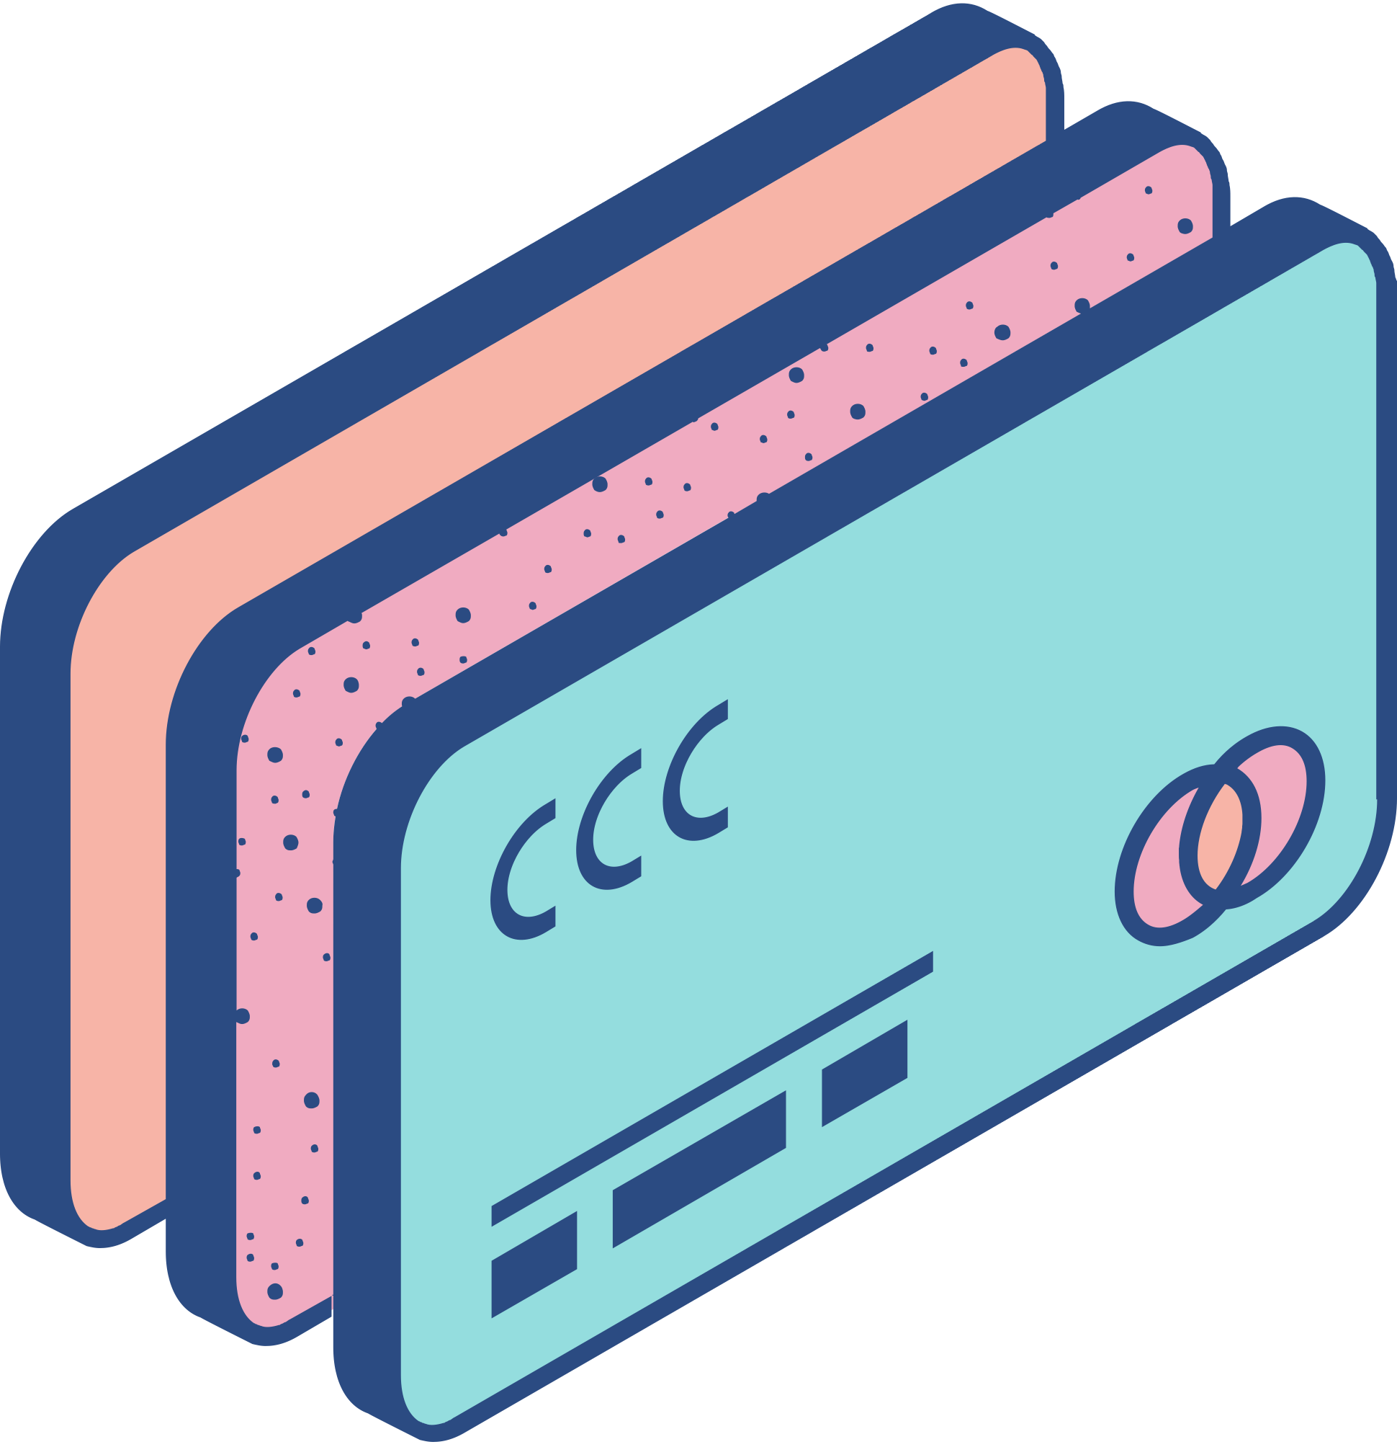
Reasons For Spiral Model
Risk Management: The Spiral Model allows us to identify and address risks early in the development cycle. By breaking the project into smaller iterations or "spirals," we can proactively mitigate potential risks, ensuring that challenges are resolved before they escalate.
Flexibility in Requirement Changes: Unlike linear models, the Spiral Model enables us to accommodate changes in requirements throughout the development process. Each iteration allows for reassessment and refinement of both features and risks, ensuring that PantryPal evolves in response to new insights or changing user needs.
Progressive Refinement: The Spiral Model supports continuous refinement of both the product and the process. With each iteration, we build upon previous versions, incorporating feedback and improvements, allowing for gradual development of features rather than a single, all-encompassing delivery at the end.
Improved Risk Control and Stakeholder Involvement: By focusing on risk management, the Spiral Model improves decision-making and ensures that stakeholders are involved in critical points throughout the process, allowing for better alignment between development efforts and business goals.

Slide 5
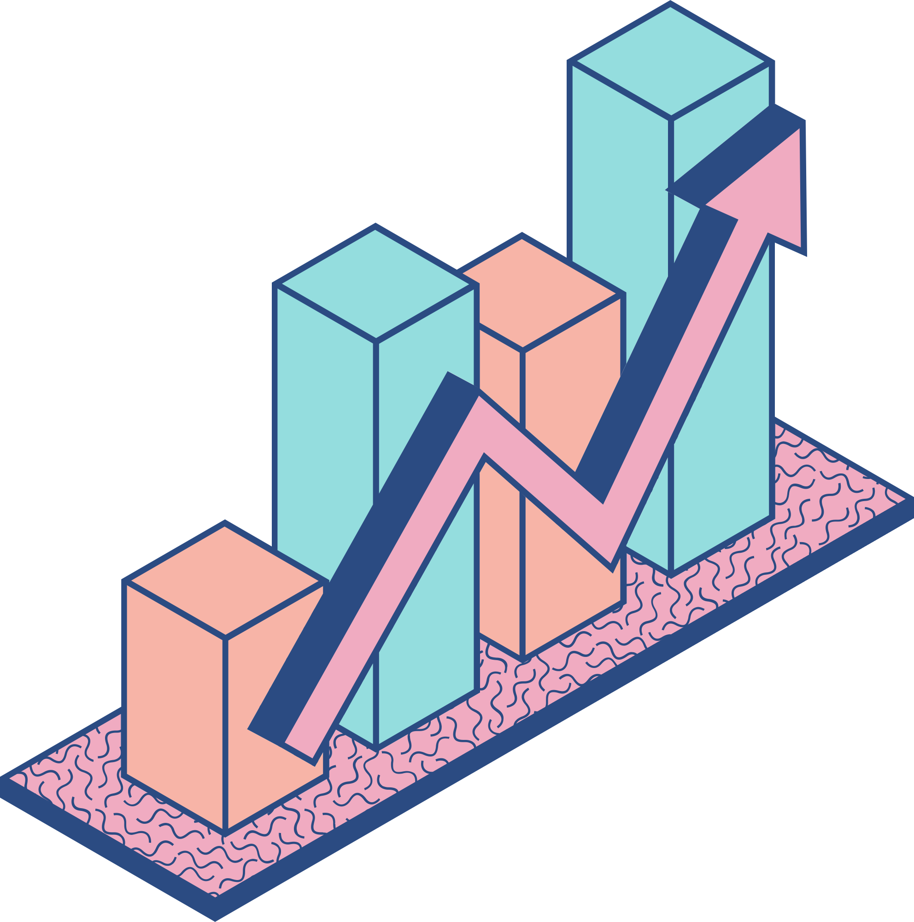
Journal Articles for Spiral Model
Reference 1: Boehm, B. W. (1988). A Spiral Model of Software Development and Enhancement. ACM SIGSOFT Software Engineering Notes, 11(4), 14-24. This foundational paper introduces the Spiral Model, emphasizing iterative risk assessment and management during software development, making it ideal for projects requiring flexibility and risk control.
Reference 2: Sommerville, I. (2016). Software Engineering (10th ed.). Pearson Education. In this comprehensive textbook, the Spiral Model is explored in the context of modern software development methodologies, highlighting its advantages in risk-driven processes and iterative improvement cycles.
Reference 3: Royce, W. (1998). Managing the Development of Large Software Systems: Concepts and Techniques. Proceedings of the 9th International Conference on Software Engineering (ICSE), IEEE, 328-338. This paper details how the Spiral Model can be applied to large-scale software development projects, focusing on balancing risk and flexibility while accommodating evolving project requirements.

Slide 6
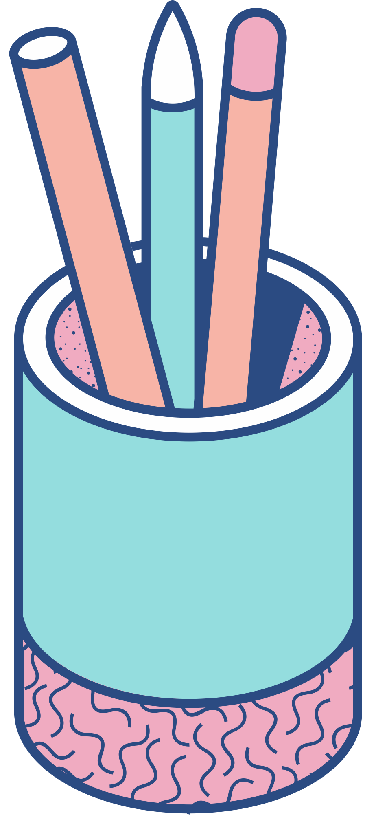
Sameer Shaik – Team Leader:
Responsible for overseeing each phase of the Spiral Model, including risk analysis, design, and prototype development. Ensures that the project progresses through iterative cycles and that any risks are identified and mitigated during each iteration.
Prakya Tummala – Product Owner:
Manages the project requirements, ensuring that each iteration aligns with stakeholder needs. Prioritizes features and requirements for each cycle of the Spiral Model, focusing on continuous refinement and risk reduction.
Vivek Kommareddy – Developer:
Develops features in line with each iteration of the Spiral Model, with a focus on implementing and refining inventory management and AI functionalities. Ensures that risks identified in each cycle are addressed during development, contributing to the ongoing prototype refinement.
How Team Follow Spiral Model

Slide 7
Creating a Shippable Product Using the Spiral Model
Development Timeframe:
Cycle Length: 1 month per spiral iteration.
Total Duration: 4 months with 4 iterations (spirals).
Milestones: Each spiral includes the following phases:
Phase 1: Requirements gathering and risk analysis.
Phase 2: Design and prototyping to address risks.
Phase 3: Development and integration of core features.
Phase 4: Testing, evaluation, and planning for the next iteration.
Deployment: After each spiral, the product is refined based on user feedback and risk evaluations, ensuring continuous progress toward a shippable product.

Slide 8
Role of Customer or Stakeholder in the Spiral Model
Customers and stakeholders provide feedback at the end of each spiral iteration. This feedback helps refine prototypes, prioritize tasks, and ensure the product evolves according to user needs.
Testing and Quality Control:
Continuous Testing: Unit and integration tests are conducted during each iteration.
User Acceptance Testing (UAT): Stakeholders test features to ensure they meet requirements and mitigate risks.
Incremental Deployment: Features are deployed after each iteration for ongoing refinement and improvement.

Slide 9




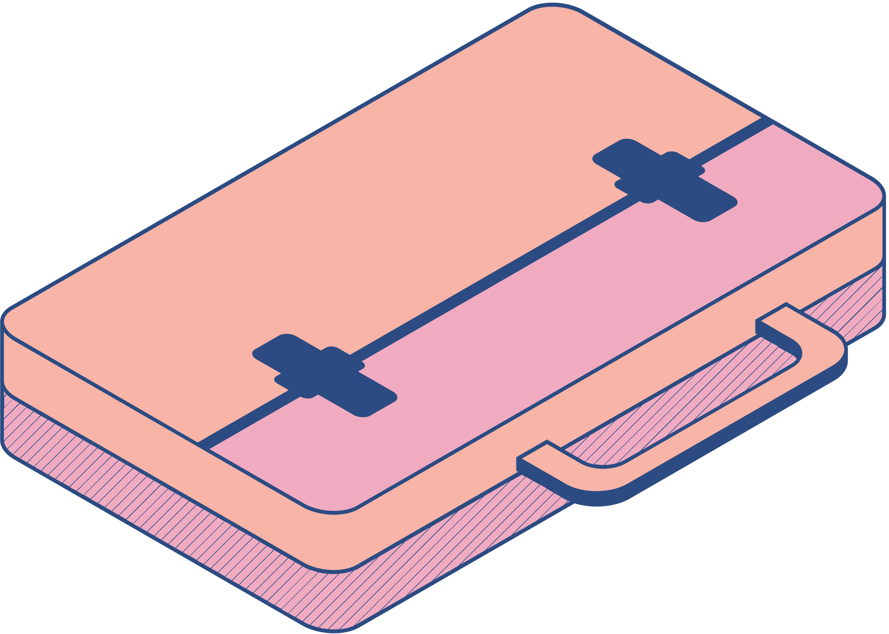
"With Auctionnest, technology transforms auctions into a safer, smarter, and more seamless experience for buyers and sellers alike."

Slide 10
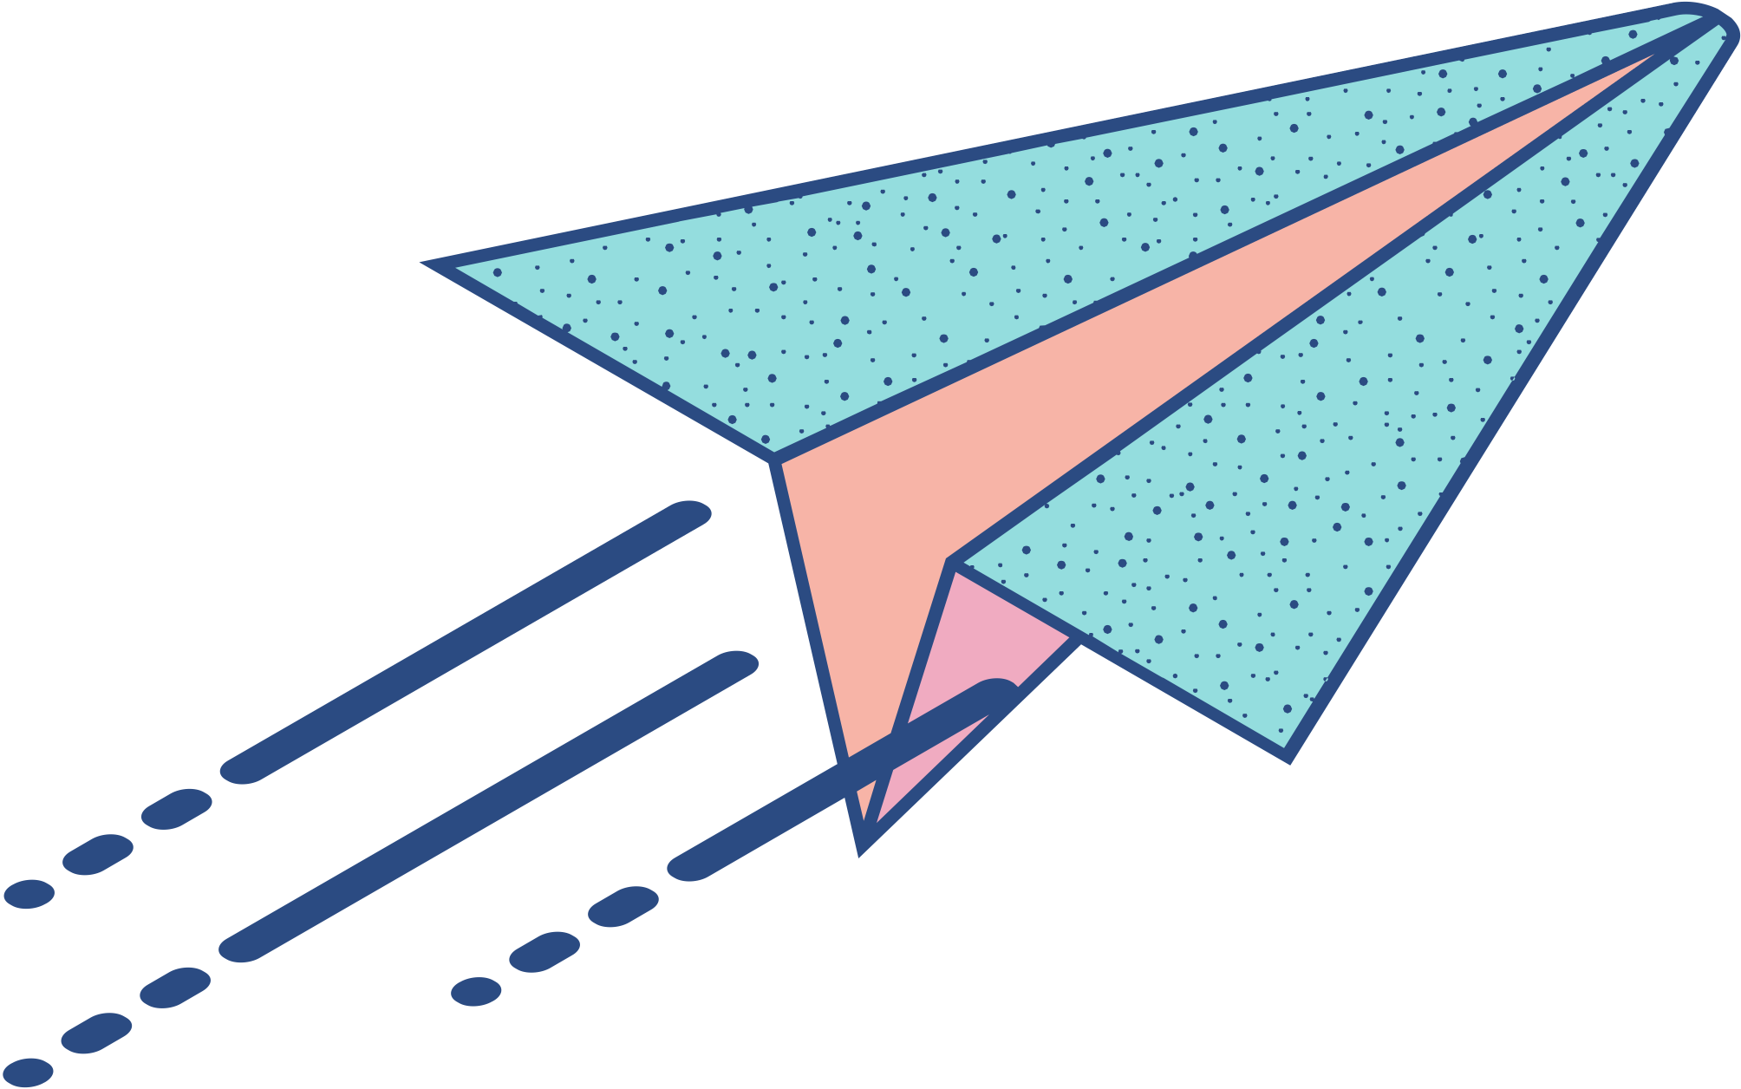
Do you have any questions?
............

